Slide 1

{ CSS }
jit.team 2018

Slide 2
Cascading Style Sheets​
language to specify how documents are presented
jit.team 2018

Slide 3
csszengarden.com
jit.team 2018

Slide 4
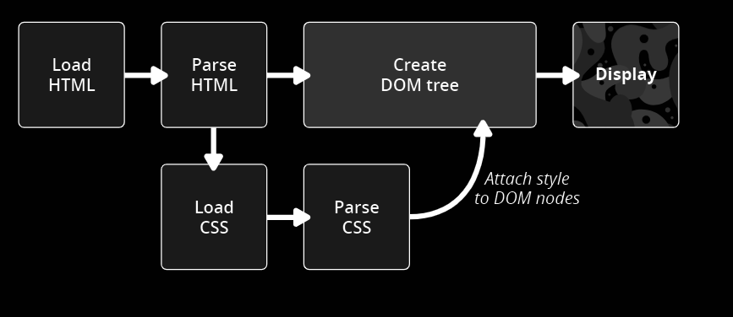
How it works?
jit.team 2018

Slide 5
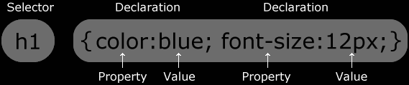
Syntax
jit.team 2018

Slide 6
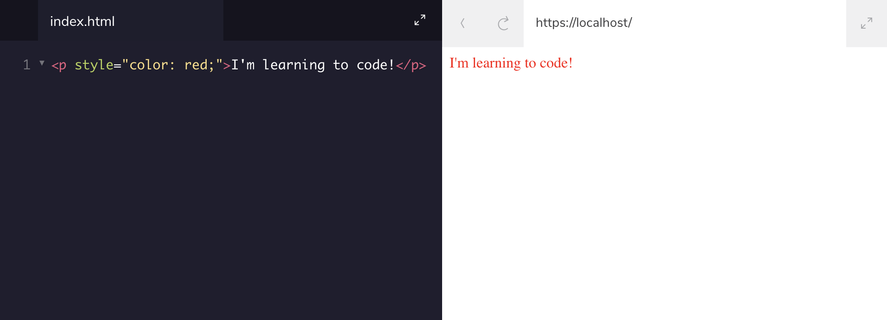
Inline styles
jit.team 2018

Slide 7
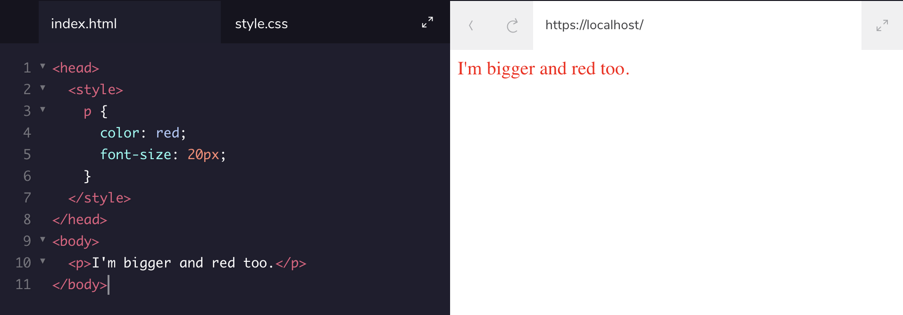
<style> tag
jit.team 2018

Slide 8
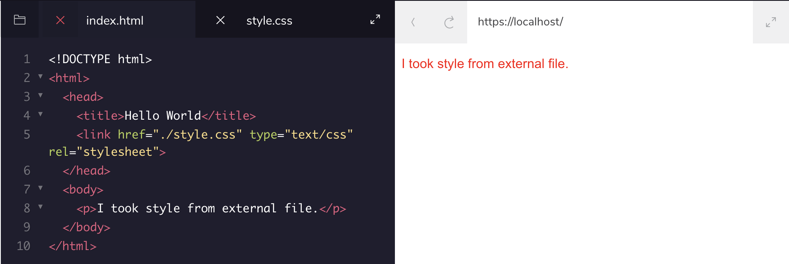
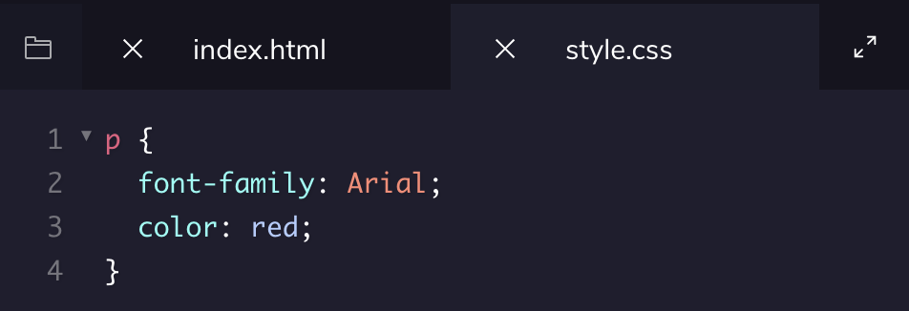
The .css file
jit.team 2018

Slide 9

Tag name
jit.team 2018

Slide 10


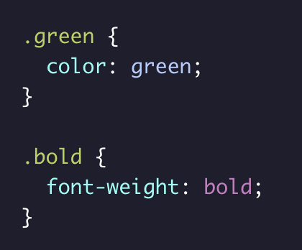
Class name
jit.team 2018

Slide 11


ID name
jit.team 2018

Slide 12
IDs and Classes
IDs override the styles of tags and classes.
IDs are UNIQUE, but classes not
There are no browser defaults for any ID or Class
http://yourdomain.com#comments
Elements can have BOTH
jit.team 2018
Notes:
https://css-tricks.com/the-difference-between-id-and-class/

Slide 13
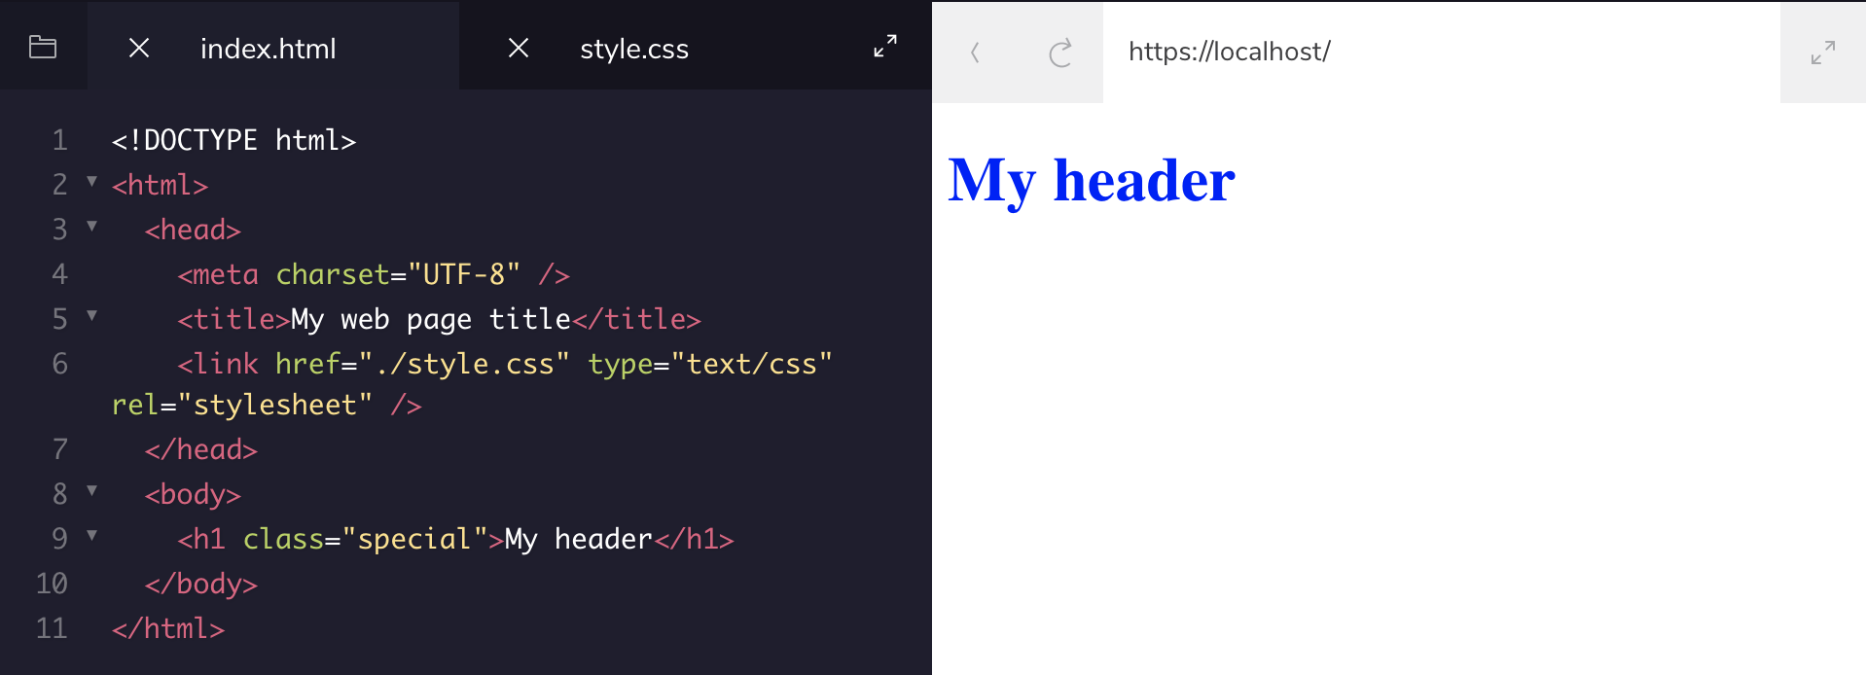

Chaining selectors
jit.team 2018

Slide 14
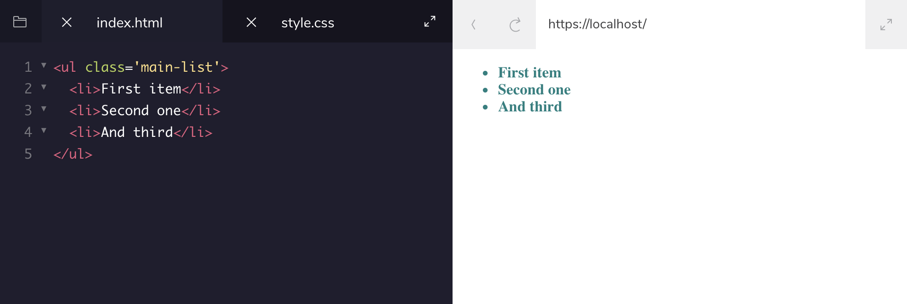
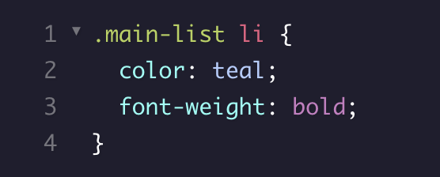
Nested elements
jit.team 2018

Slide 15

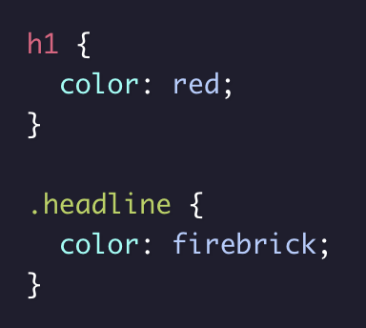
Specificity
Specificity is the order by which the browser decides which CSS styles will be displayed.
What about IDs?
jit.team 2018
Notes:
https://css-tricks.com/the-difference-between-id-and-class/

Slide 16
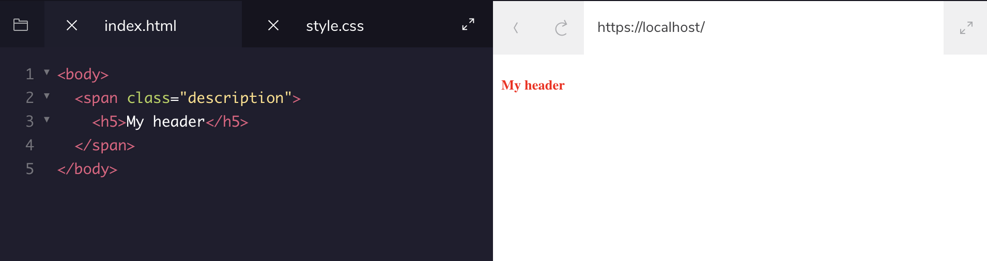
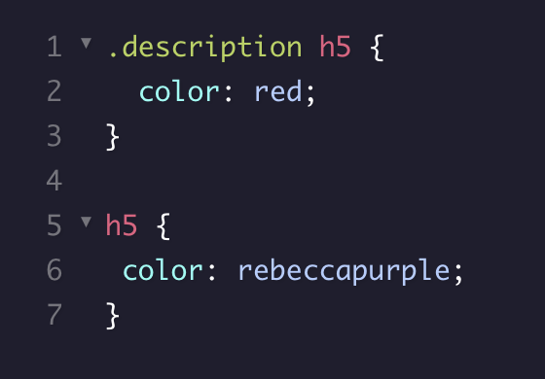
Chaining and specificity
Adding more than one tag, class, or ID to a CSS selector increases the specificity of the CSS selector.
jit.team 2018

Slide 17
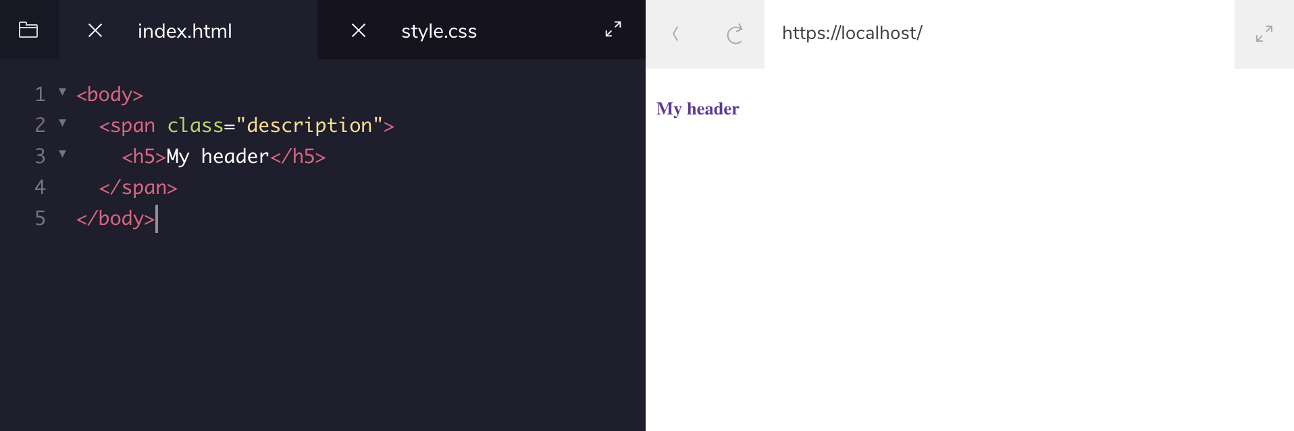

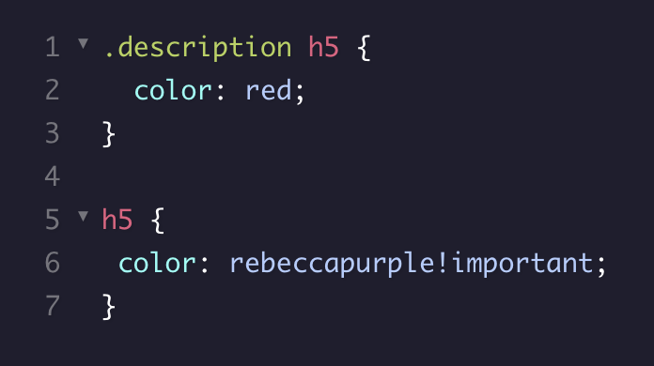
!Important
jit.team 2018

Slide 18
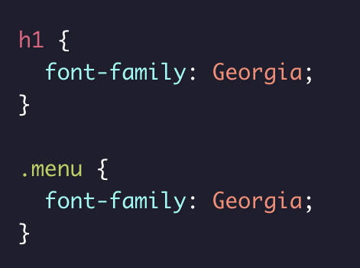
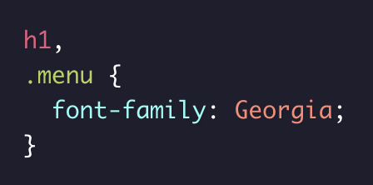
Multiple selectors
=
jit.team 2018
Notes:
https://css-tricks.com/the-difference-between-id-and-class/

Slide 19
Basic properties
color: white, #FFF, rgb(255, 255, 255)
background-color: black
font-family: Times New Roman
font-size: 18px, 2em, 3rem
opacity: 0.5
background-image: url(“./image.png”)
font-weight: bold, normal
text-align: right, center, left
jit.team 2018
Notes:
https://css-tricks.com/the-difference-between-id-and-class/

Slide 20
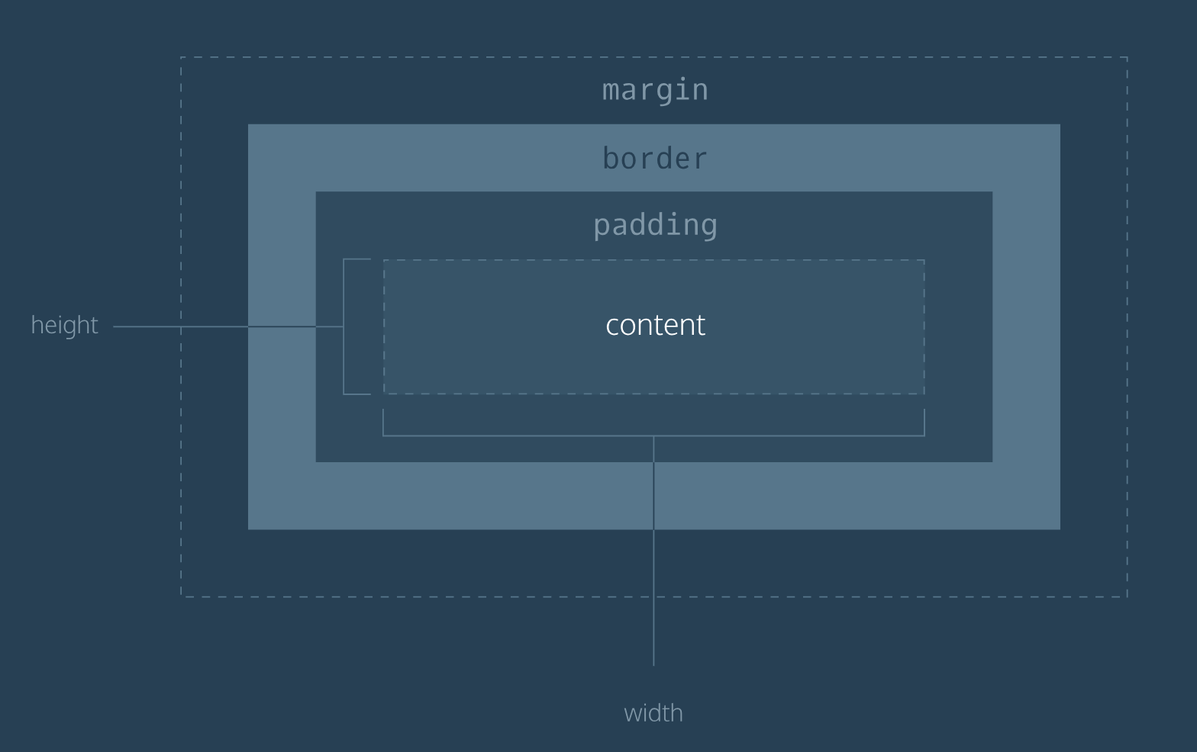
Box
model
jit.team 2018
Notes:
https://css-tricks.com/the-difference-between-id-and-class/

Slide 21
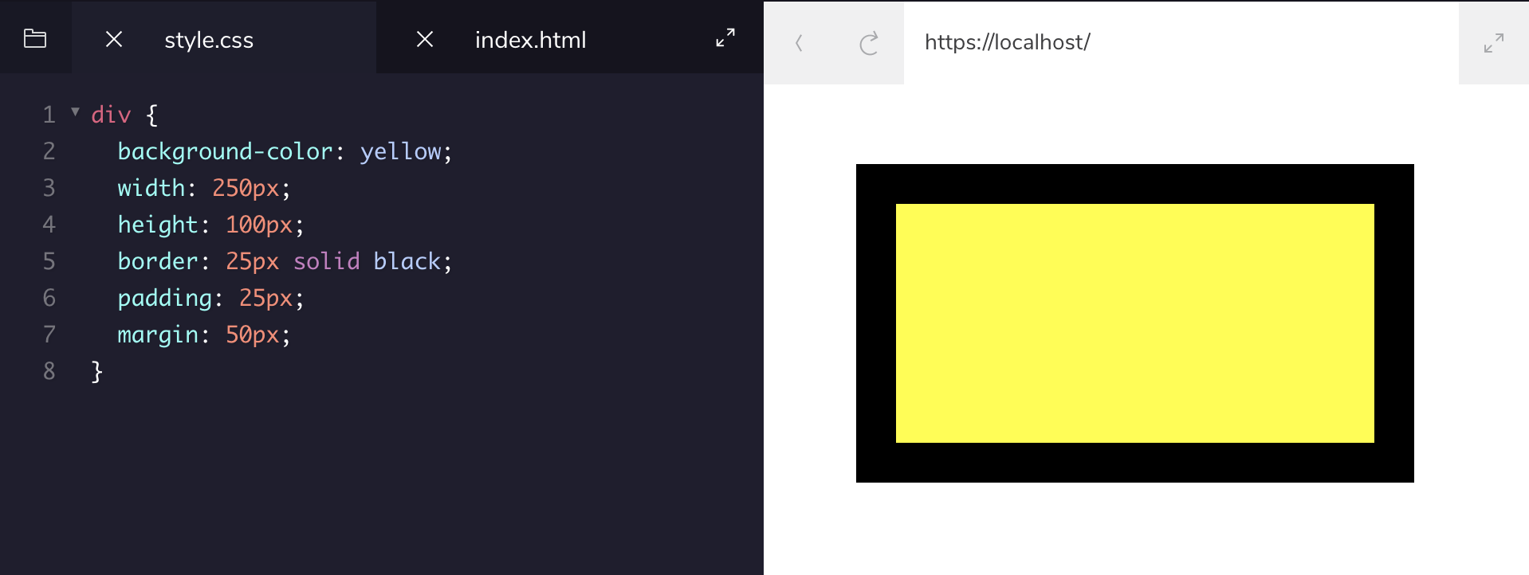
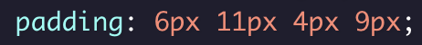

Box model
jit.team 2018
Notes:
https://css-tricks.com/the-difference-between-id-and-class/

Slide 22
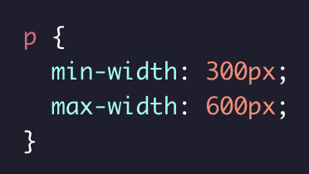
Box model
The width of all paragraphs will not shrink below 300 pixels, nor will the width exceed 600 pixels.
jit.team 2018
Notes:
https://css-tricks.com/the-difference-between-id-and-class/

Slide 23
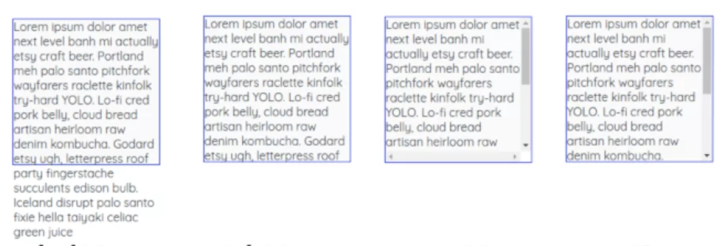
Overflow
visible
hidden
scroll
overflow-y
jit.team 2018
Notes:
https://css-tricks.com/the-difference-between-id-and-class/

Slide 24
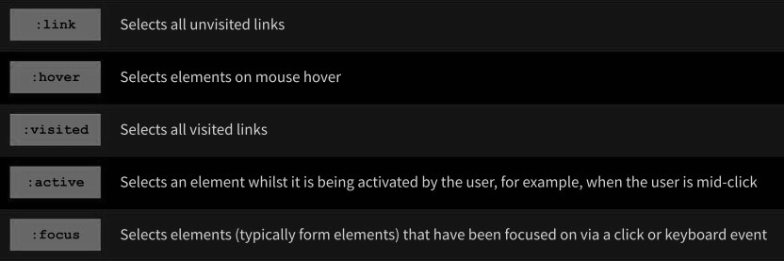
Pseudo-classes
jit.team 2018
Notes:
https://css-tricks.com/the-difference-between-id-and-class/

Slide 25
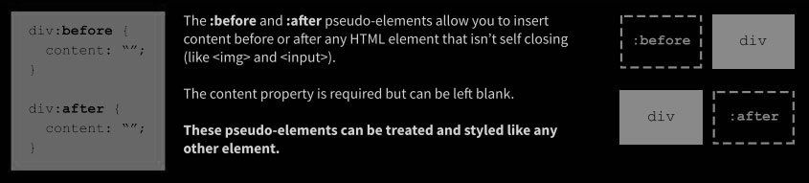
Pseudo-elements
jit.team 2018
Notes:
https://css-tricks.com/the-difference-between-id-and-class/

Slide 26
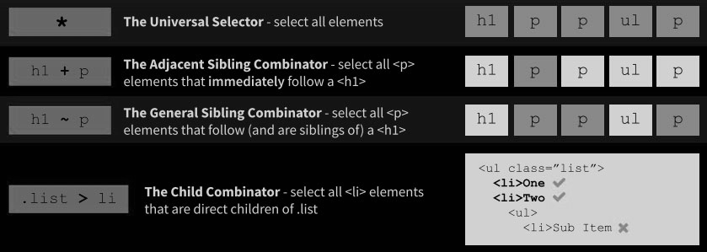
Combinators
jit.team 2018
Notes:
https://css-tricks.com/the-difference-between-id-and-class/

Slide 27
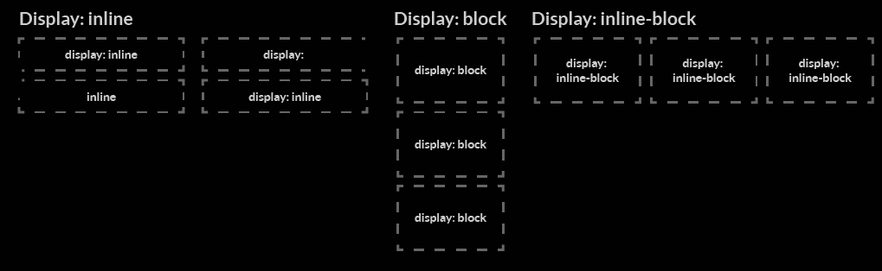
Categories of HTML elements
jit.team 2018

Slide 28
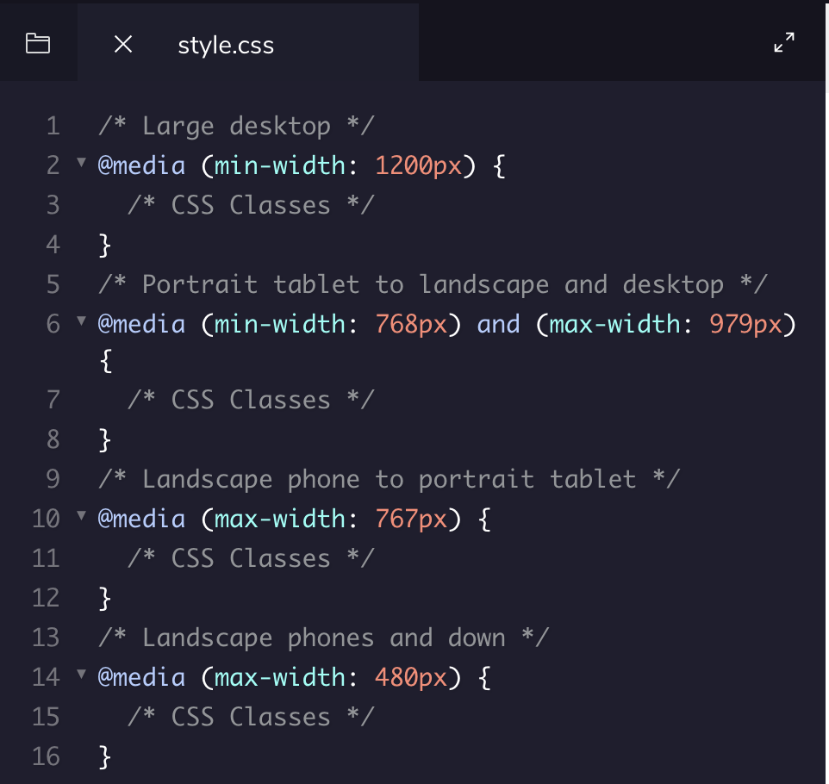

Media queries
jit.team 2018

Slide 29

Flexible Box Layout Module
Flexbox - makes easier to design flexible responsive layout structure
jit.team 2018

Slide 30
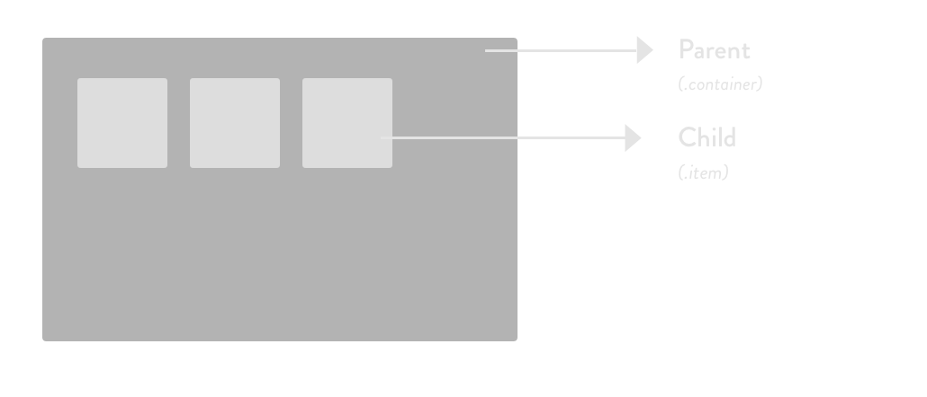
Flexbox
jit.team 2018

Slide 31
Flexbox
Flex container properties:
flex-direction flex-wrap flex-flow justify-content align-items align-content
Flex item properties:
order flex-grow flex-shrink flex-basis flex align-self
jit.team 2018

Slide 32
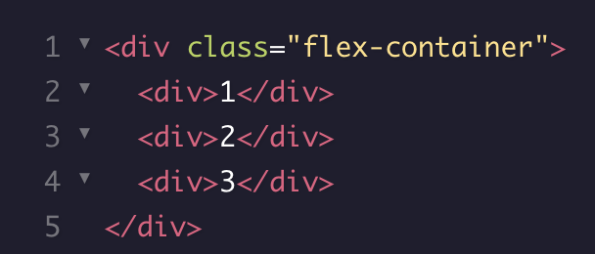
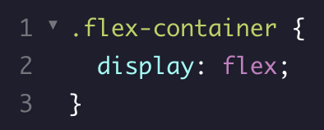

Flexbox
jit.team 2018

Slide 33
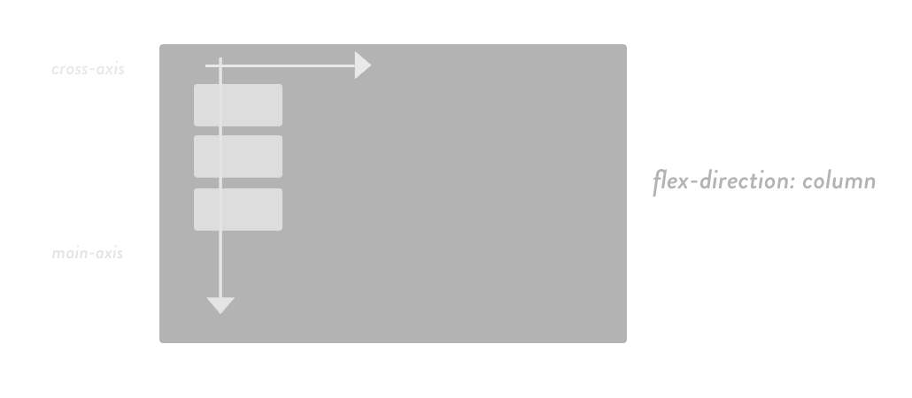
Flexbox flex-direction
jit.team 2018

Slide 34

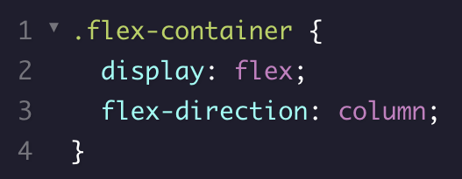
Flexbox flex-direction
jit.team 2018

Slide 35
flexboxfroggy.com
jit.team 2018

Slide 36
Workshop #1
First page
postcards list polishing
jit.team 2018

Slide 37
Workshop #2
Second page
postcards share form polishing
jit.team 2018

